Slide 1
Final SRS Presentation
Santosh Thapa

Slide 2

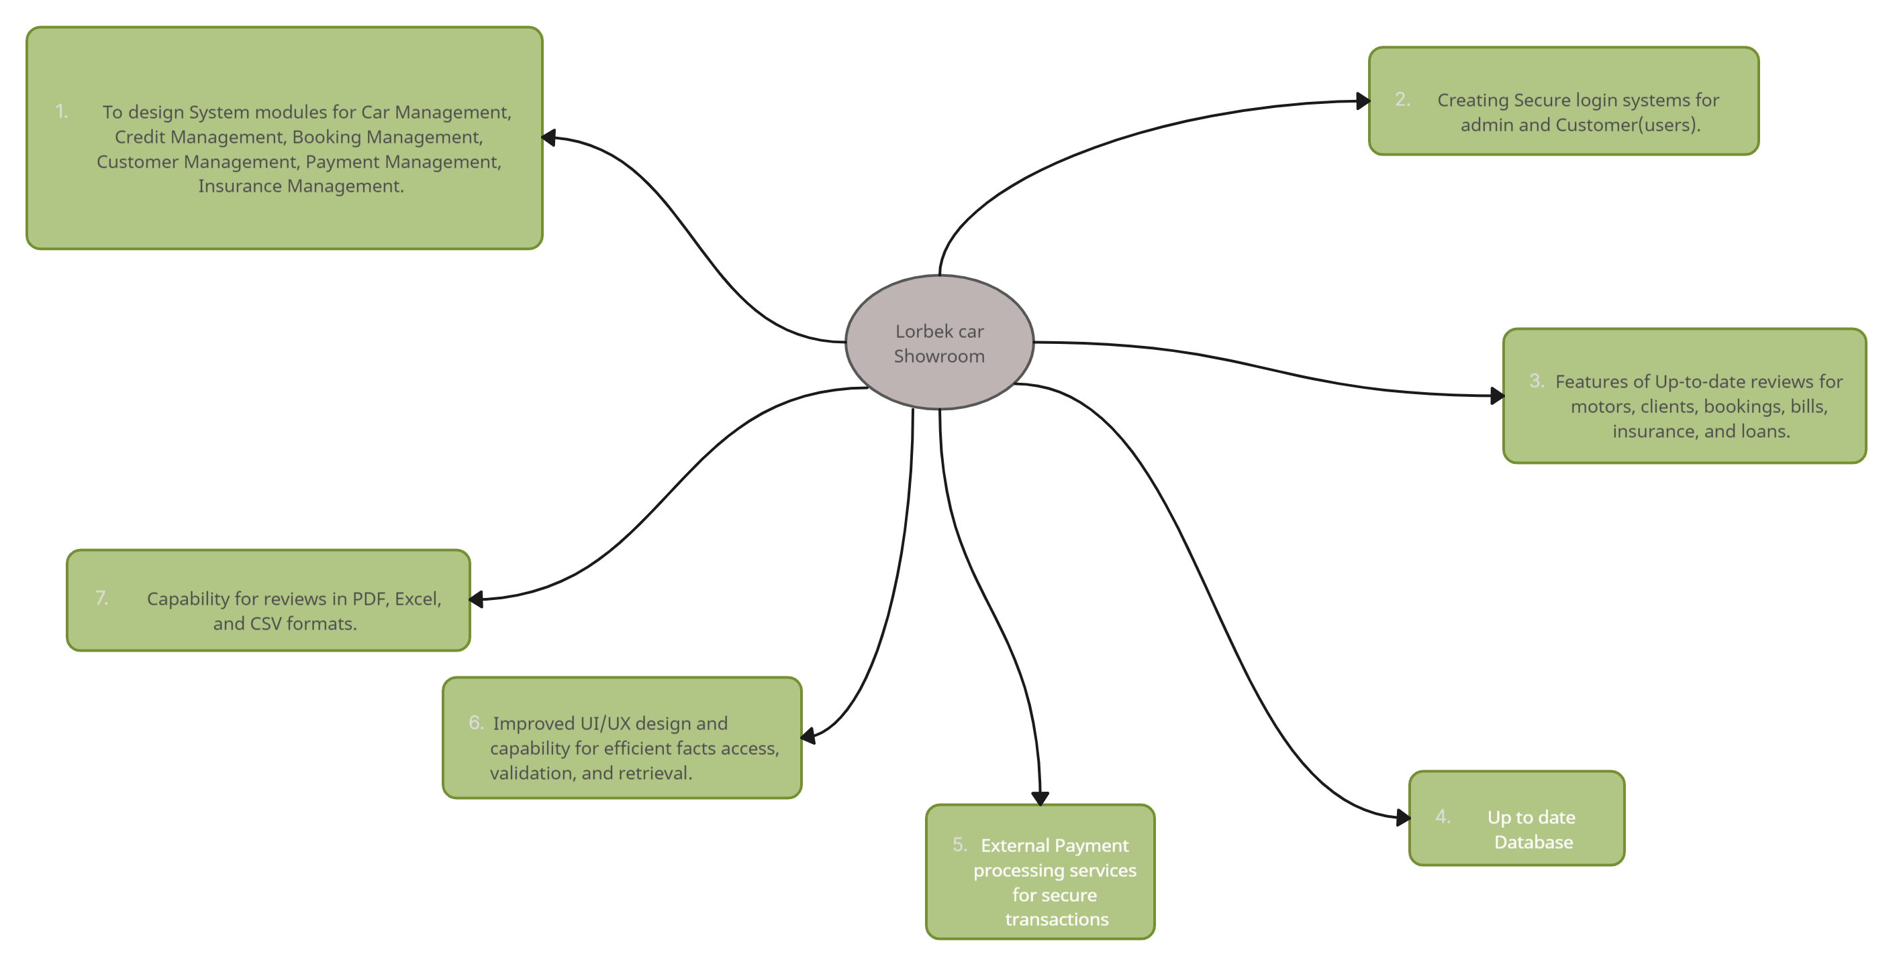
Scope of the Project

Slide 3

Limitations of projects
Internet Dependency
System is online base.
Consequences: All the Users need Reliable internet connection if they want to use the system.
Data Accuracy
What data users give system will take them.
Consequences: If users give wrong data system will not give Reliable and accurate results.
Budget And Scope Creep
short time for project completion
Consequences: Adding new features will delay the project and increase the budget.
Integration Challenges
Different hardware in market
Consequences: System might not efficiently in new and updated technology after the project completion.
Training Requirement
Lorbek is not much familiar to technology.
Consequences: Required Effective and enough Training.
Dynamic Security Demands
Technology is growing and new risk in the market everyday.
Need to match the pace with growing technology and make required update on time.

Slide 4
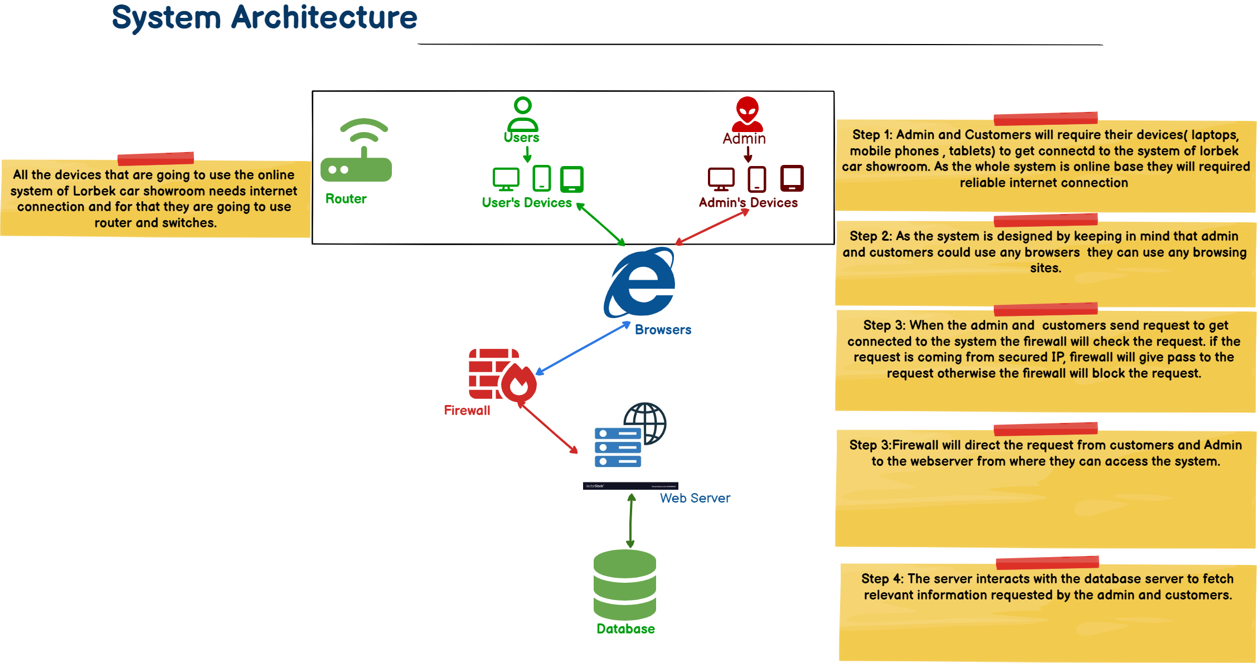
System Architecture

Slide 5
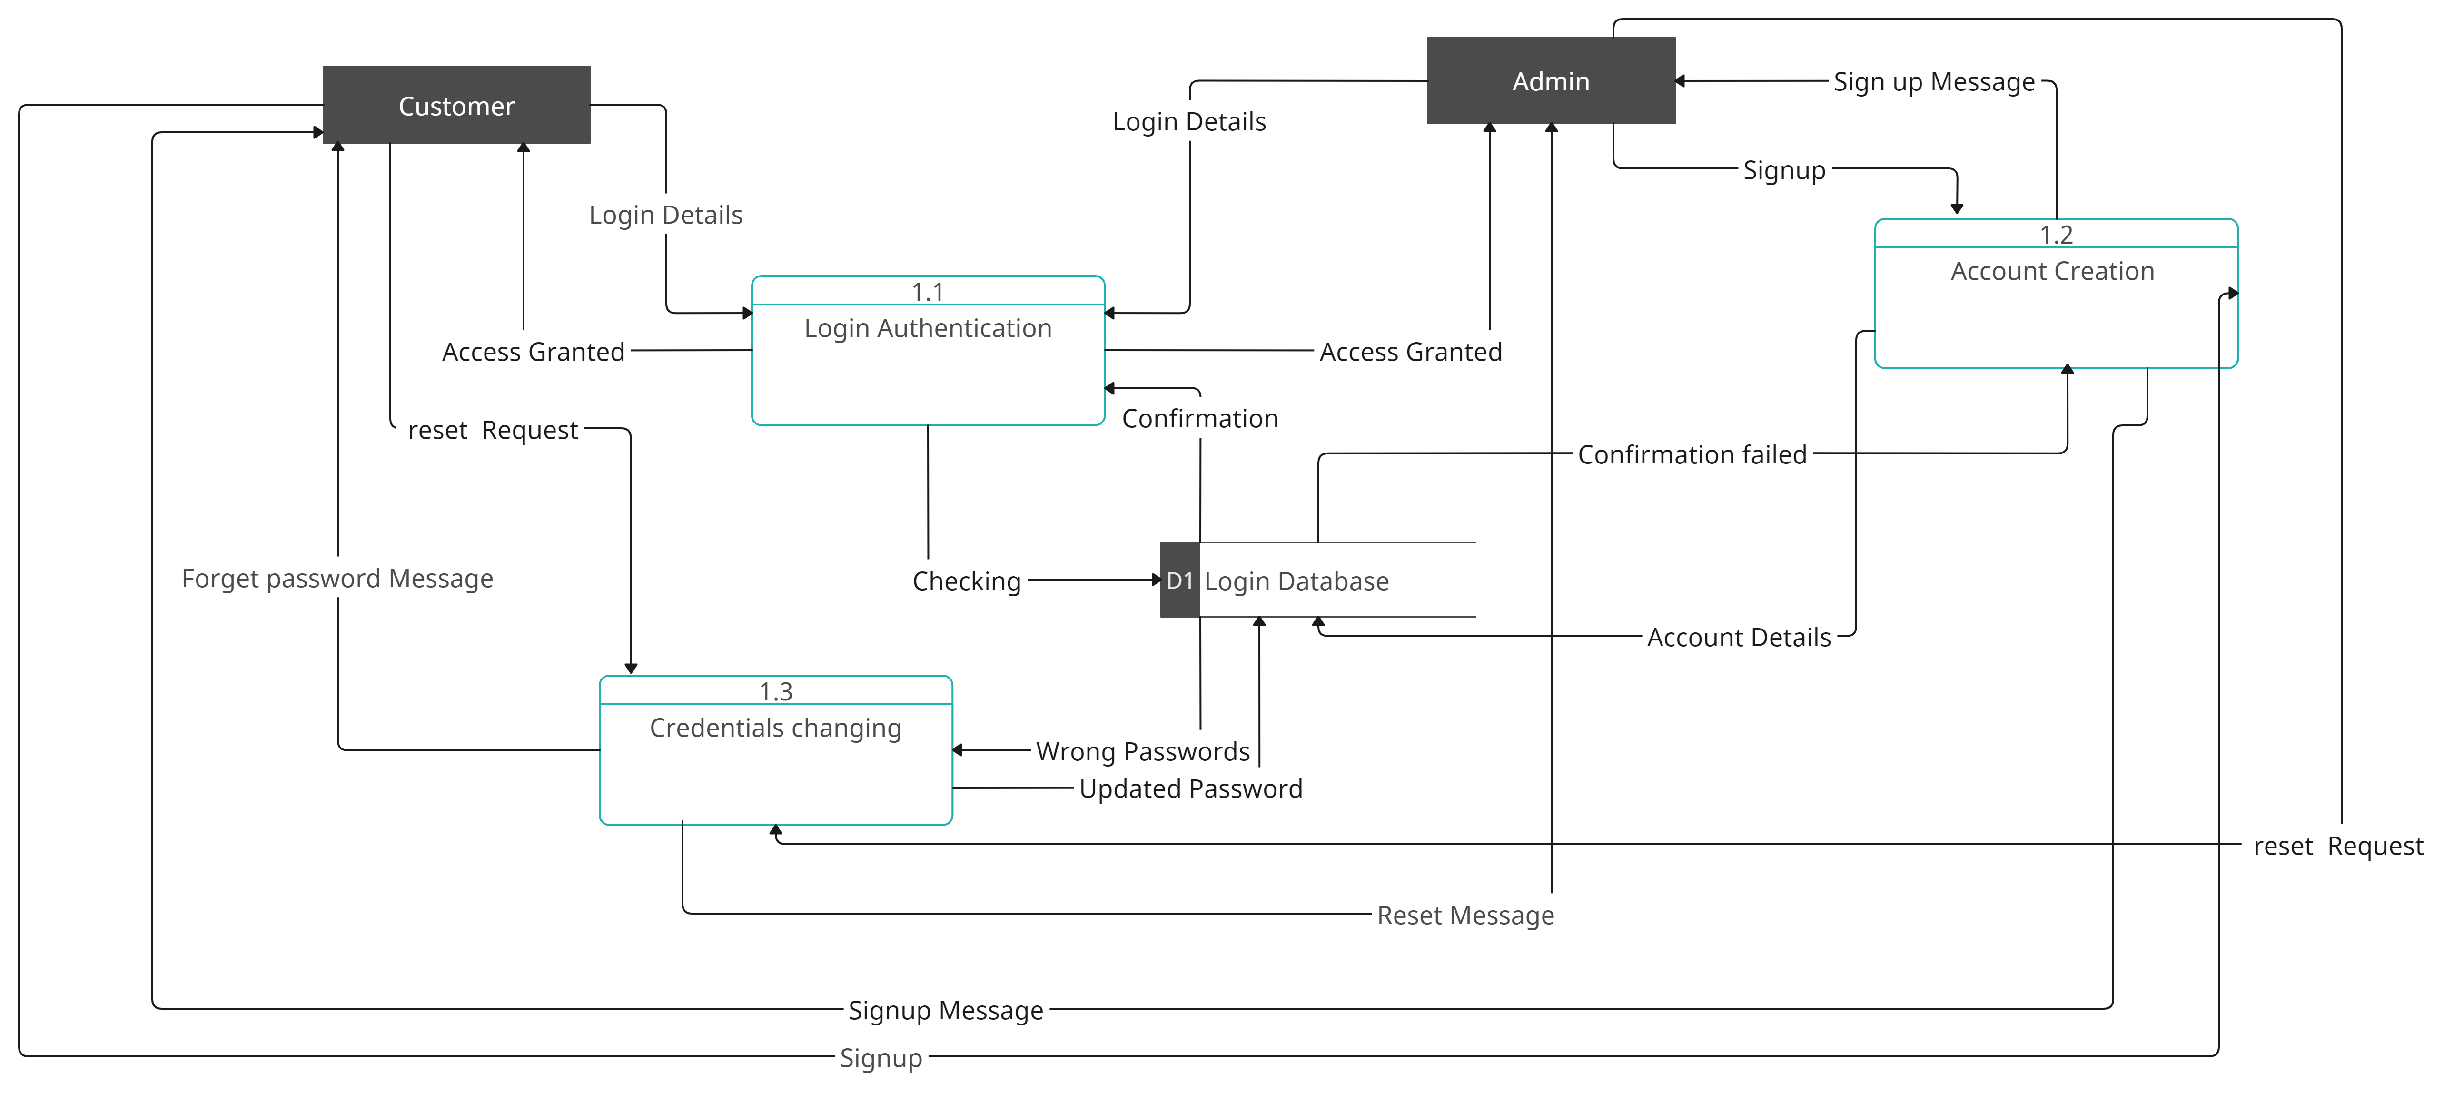
Login DFD level 2

Slide 6
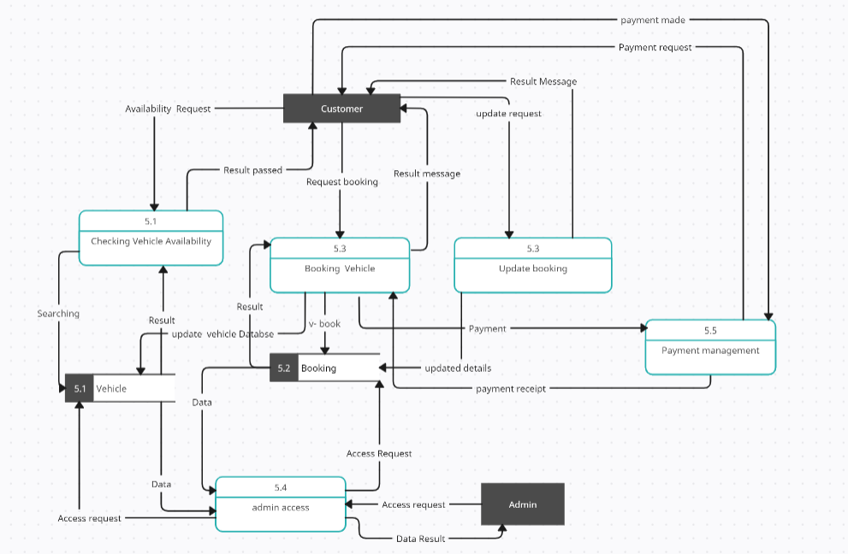
Booking DFD level 2

Slide 7

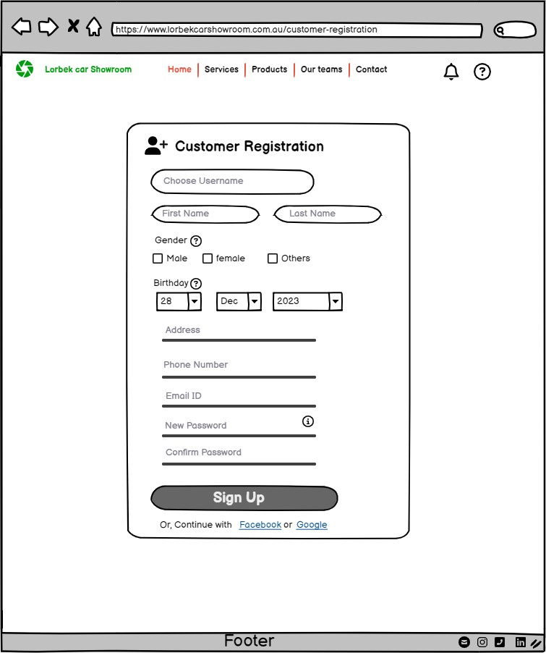
Customer Signup UI

Slide 8
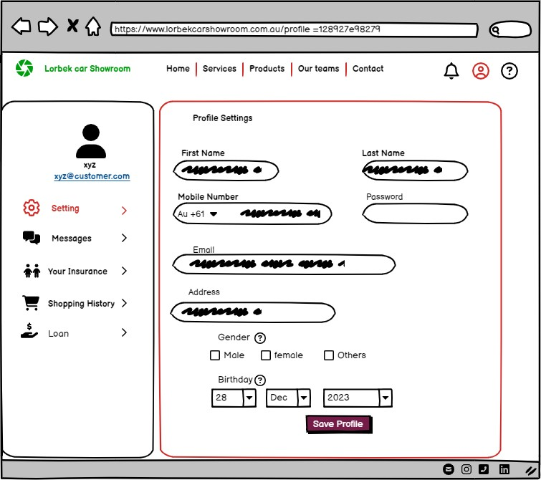
Customer Dashboard

Slide 9
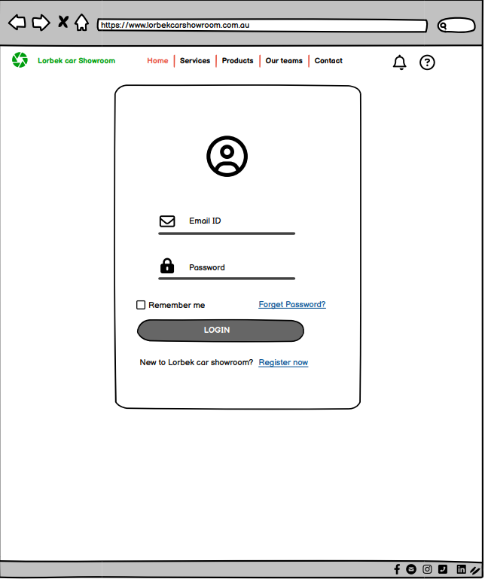
Customer Login

Slide 10
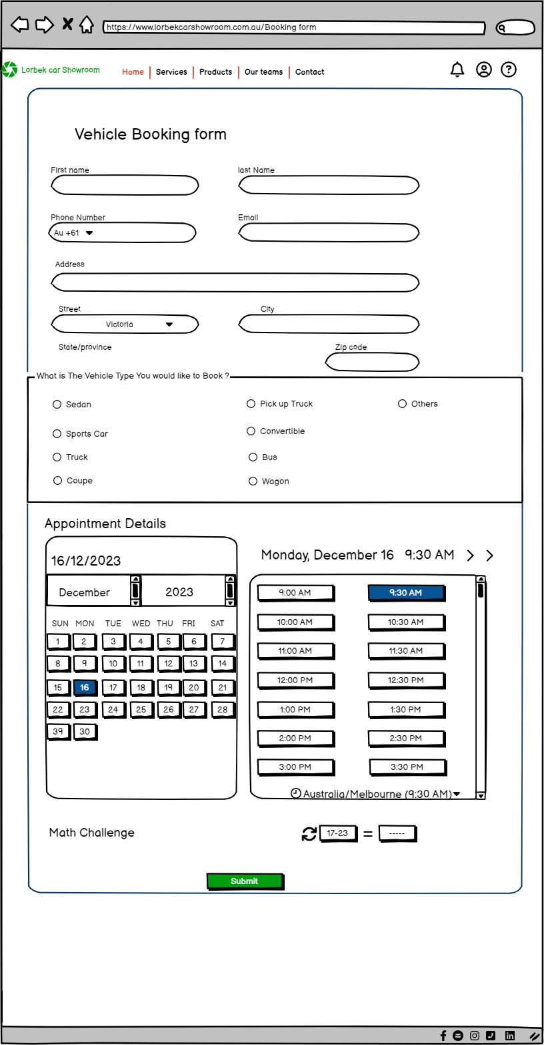
Vehicle Booking Form

Slide 11
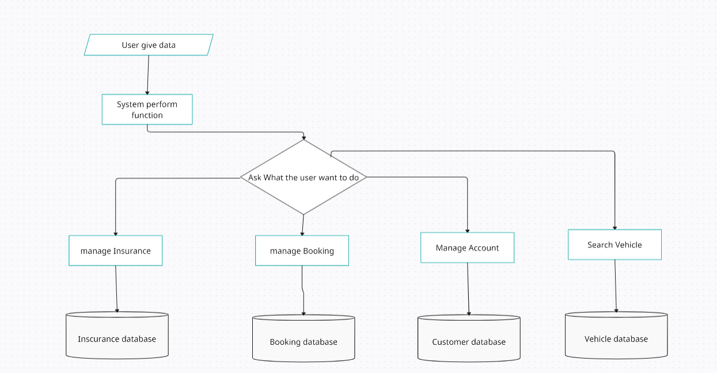
Data Collecting process

Slide 12
Risk Register

Slide 13
Risk Mitigation
Possible Risks in Lorbek Car showroom Online System | Mitigation Measures (1-5) | Effect on risk5) | Residual risk | Measured Approved
Data Breaches | Regular security Audits and Vulnerability assessment along with using two-factor Authentication in Lorbek System. | Reduced | Low | Yes
Data inaccuracies | Implementing data validation and automated reconciliation processes in the input fields and providing training to users. | Reduced | medium | yes
DDoS Attacks | Using firewalls and setting the limitation of traffic to reach server. | accepted | medium | yes
Customer service failure | Gathering feedback from users and checking the issues reported by users. | Reduced | low | yes
Technological Obsolescence | Regular system updates and doing strategic planning for any possible new technology | Eliminated | High | yes

